Slide 1
CS 168 Multiple Access and Security
Fall 2015
Scott Shenker
http://inst.eecs.berkeley.edu/~cs168/fa15/

Slide 2

Ssssshhhhhhhhhhhhhhh

Slide 3
Some History
Ethernet was invented as a broadcast technology
Each packet received by all attached hosts
Easy to set up, cheap to build
But hosts had to share channel (multiple access)
Current Ethernets are “switched”
No sharing
But sharing a channel is conceptually important
Multiple access is also used in wireless

Slide 4
Multiple Access Control (MAC)
Single shared broadcast channel
Must avoid having multiple nodes speaking at once
Otherwise, collisions lead to garbled data
Need distributed algorithm for sharing the channel
Algorithm determines which node can transmit
Classes of techniques
Channel partitioning: divide channel into pieces
Taking turns: scheme for trading off who gets to transmit
Random access: allow collisions, and then recover
We focus on this last approach (most Internet-like!)

Slide 5
Random Access MAC Protocols
When node has packet to send
Transmit at full channel data rate
No a priori coordination among nodes
Two or more transmitting nodes ⇒ collision
Data lost
Random access MAC protocol specifies:
How to detect collisions
How to recover from collisions
Examples
ALOHA and Slotted ALOHA (background)
CSMA, CSMA/CD, CSMA/CA (used in practice)

Slide 6
Key Ideas of Random Access
Carrier sense
Listen before speaking, and don’t interrupt
Checking if someone else is already sending data
… and waiting till the other node is done
Collision detection
If someone else starts talking at the same time, stop
But make sure everyone knows there was a collision!
Realizing when two nodes are transmitting at once
…by detecting that the data transmission is garbled
Randomness
Don’t start talking again right away
Waiting for a random time before trying again

Slide 7

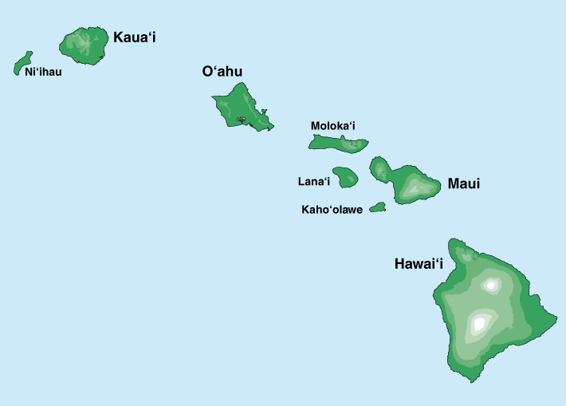
Where it all Started: AlohaNet
Norm Abramson left Stanford in 1970
So he could surf!
Set up first data communication system for Hawaiian islands
Hub at U. Hawaii, Oahu
Had two radio channels:
Random access:
Sites sending data
Broadcast:
Hub rebroadcasting data
Notes:
Who is he, and why is he my hero?

Slide 8
Aloha Signaling
Two channels: random access, broadcast
Sites send packets to hub (random)
If received, hub sends ACK (random)
If not received (due to collision), site resends
Hub sends packets to all sites (broadcast)
Sites can receive even if they are also sending
Questions:
When do you resend? Resend with probability p
How does this perform? Need a clean model….

Slide 9
Slotted ALOHA
Assumptions
All frames same size
Time divided into equal slots (time to transmit a frame)
Nodes are synchronized
Nodes begin to transmit frames only at start of slots
If multiple nodes transmit, nodes detect collision
Operation
When node gets fresh data, transmits in next slot
No collision: success!
Collision: node retransmits on each slot with probability p until success

Slide 10
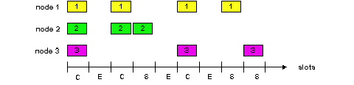
Slot-by-Slot Example

Slide 11
Efficiency of Slotted Aloha
Suppose N stations have packets to send
Each transmits in slot with probability p
Probability of successful transmission: by a particular node i: S_{i} = p (1-p)^{(N-1)} by any of N nodes: S= N p (1-p)^{(N-1)}
What value of p maximizes prob. of success:
For fixed p, S ➔ 0 as N increases
But if p = 1/N, then S ➔ 1/e = 0.37 as N increases
Max efficiency is only slightly greater than 1/3!

Slide 12
Pros and Cons of Slotted Aloha
Pros
Single active node can continuously transmit at full rate of channel
Highly decentralized: only need slot synchronization
Simple
Pros
Single active node can continuously transmit at full rate of channel
Highly decentralized: only need slot synchronization
Simple
Cons
Wasted slots:
Idle
Collisions
Collisions consume entire slot
Clock synchronization
Notes:
Why is clock synchonization necessary?
It isn’t, but if we get rid of it, efficiency goes down…

Slide 13
Improving on Slotted Aloha for Enet
Fewer wasted slots
Need to decrease collisions and empty slots
Don’t waste full slots on collisions
Need to decrease time to detect collisions
Avoid need for synchronization
Synchronization is hard to achieve
And Aloha performance drops if you don’t have slots
Notes:
Which of these are the most important!

Slide 14
CSMA (Carrier Sense Multiple Access)
CSMA: listen before transmit
If channel sensed idle: transmit entire frame
If channel sensed busy, defer transmission
Human analogy: don’t interrupt others!
Does this eliminate all collisions?
No, because of nonzero propagation delay

Slide 15
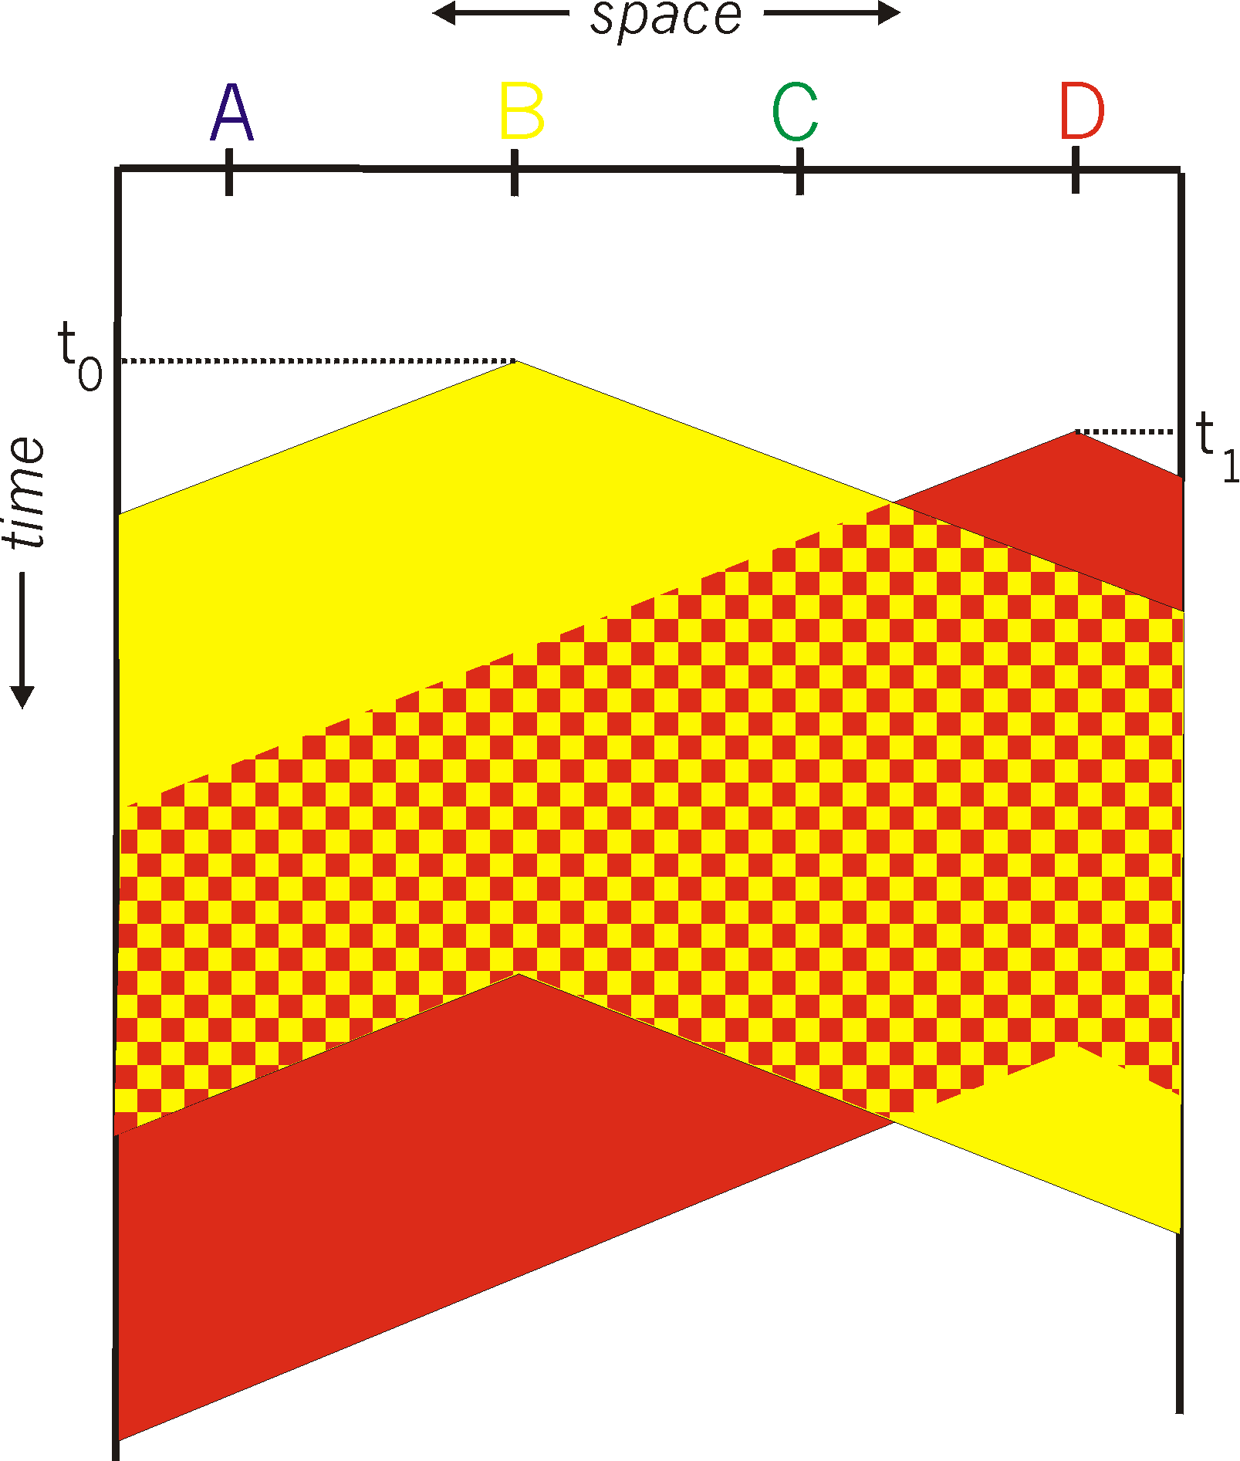
CSMA Collisions
Propagation delay: two nodes may not hear each other’s before sending.
Would slots hurt or help?
CSMA reduces but does not eliminate collisions
Biggest remaining problem?
Collisions still take full slot!
How do you fix that?
Notes:
Ask: who knows? (from knowing ethernet)?
Someone who doesn’t, how to do this?
Listen before sending to detect possible collision
Why not listen to detect current collision!

Slide 16
CSMA/CD (Collision Detection)
CSMA/CD: carrier sensing, deferral as in CSMA
Collisions detected within short time
Colliding transmissions aborted, reducing wastage
Collision detection easy in wired LANs:
Compare transmitted, received signals
Collision detection difficult in wireless LANs:
Reception shut off while transmitting (well, perhaps not)
Not perfect broadcast (limited range) so collisions local
Leads to use of collision avoidance instead
Will discuss in later in lecture

Slide 17
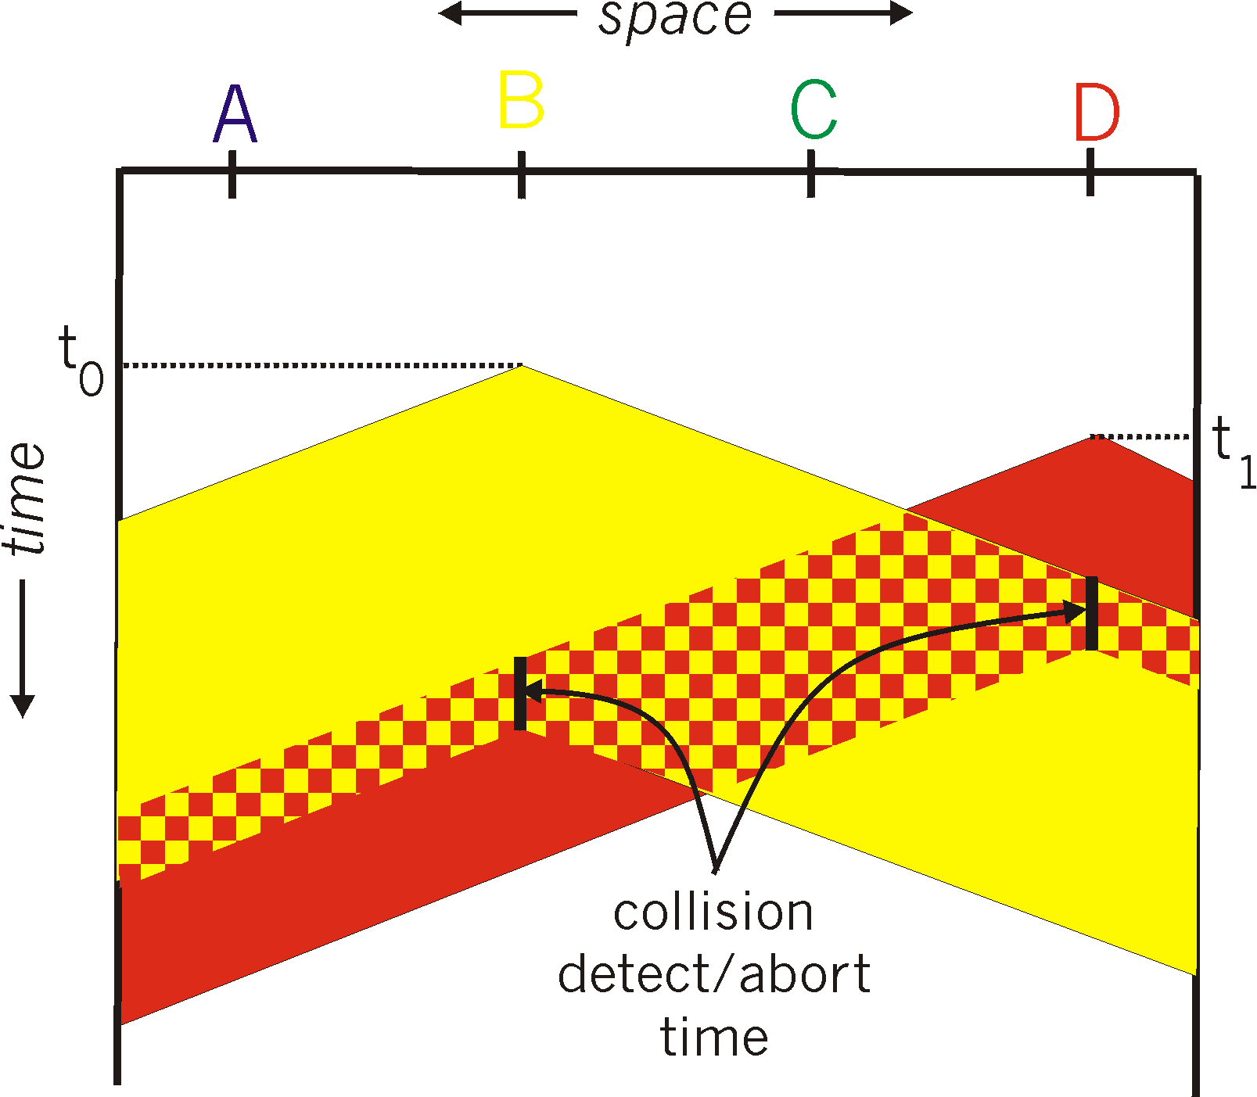
CSMA/CD Collision Detection
B and D can tell that collision occurred.
Note: for this to work, need restrictions on minimum frame size and maximum distance.
Why?
Notes:
Draw failed collision detection….

Slide 18
Limits on CSMA/CD Network Length
A
B
latency d
Latency depends on physical length of link
Time to propagate a packet from one end to the other
Suppose A sends a packet at time t
And B sees an idle line at a time just before t+d
… so B happily starts transmitting a packet
B detects a collision, and sends jamming signal
But A can’t see collision until t+2d

Slide 19
Limits on CSMA/CD Network Length
A
B
latency d
A needs to wait for time 2d to detect collision
So, A should keep transmitting during this period
… and keep an eye out for a possible collision
Imposes restrictions. E.g., for 10 Mbps Ethernet:
Maximum length of the wire: 2,500 meters
Minimum length of a frame: 512 bits (64 bytes)
512 bits = 51.2 μsec (at 10 Mbit/sec)
For light in vacuum, 51.2 μsec ≈ 15,000 meters vs. 5,000 meters “round trip” to wait for collision
What about 10Gbps Ethernet?
Notes:
10Gbps is switched, doesn’t have this problem!!!

Slide 20

Performance of CSMA/CD
Time wasted in collisions
Proportional to distance d
Time spend transmitting a packet
Packet length p divided by bandwidth b
Rough estimate for efficiency (K some constant)
Note:
For large packets, small distances, E ~ 1
As bandwidth increases, E decreases
That is why high-speed LANs are all switched
Notes:
K represents number of collisions per transmission….

Slide 21
Ethernet Multiple Access
First widely deployed multiple access

Slide 22
Benefits of Ethernet
Easy to administer and maintain
Inexpensive
Increasingly higher speed
Evolvable!

Slide 23
Evolution of Ethernet
Changed everything except the frame format
From single coaxial cable to hub-based star
From shared media to switches
From electrical signaling to optical
Lesson #1
The right interface can accommodate many changes
Implementation is hidden behind interface
Lesson #2
Really hard to displace the dominant technology
Slight performance improvements are not enough

Slide 24
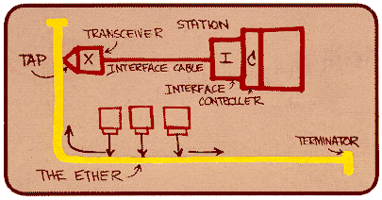
Ethernet: CSMA/CD Protocol
Carrier sense: wait for link to be idle
Collision detection: listen while transmitting
No collision: transmission successful
Collision: abort transmission & send jam signal
Random access: binary exponential back-off
After collision, wait a random time before trying again
After m^{th} collision, choose K randomly from {0, …, 2^{m}-1}
… and wait for K*512 bit times before trying again
Using min packet size as “slot”
If transmission occurring when ready to send, wait until end of transmission (CSMA)

Slide 25
Binary Exponential Backoff (BEB)
Think of time as divided in slots
After each collision, pick a slot randomly within next 2^{m} slots
Where m is the number of collisions since last successful transmission
Questions:
Why backoff?
Why random?
Why 2^{m}?
Notes:
How would listening help?

Slide 26
Behavior of BEB Under Light Load
Look at collisions between two nodes
First collision: pick one of the next two slots
Chance of success after first collision: 50%
Second collision: pick one of the next four slots
Chance of success after second collision: 75%
In general: after m^{th} collision
Chance of success: 1-2^{-m}
But the delay also increases with m….

Slide 27
BEB: Theory vs Reality
In theory, there is no difference between theory and practice. But, in practice, there is.

Slide 28
BEB Reality
Performs well (far from optimal, but no one cares)
Large packets are ~23 times as large as minimal slot
Is mostly irrelevant
Almost all current ethernets are switched

Slide 29
BEB Theory
A very interesting algorithm
Stability for finite N only proved in 1985
Ethernet can handle nonzero traffic load without collapse
Greenberg et al. (AT&T)
All backoff algorithms unstable for infinite N (1985)
Poisson model: infinite user pool, total demand is finite
David Aldous (UCB Statistics)
Not of practical interest, but gives important insight
Multiple access should be in your “bag of tricks”
Notes:
e.g., know most important way to spread a rumor…

Slide 30
Question
Two hosts, each with infinite packets to send
What happens under BEB?
Throughput high or low?
Bandwidth shared equally or not?

Slide 31
MAC “Channel Capture” in BEB
Finite chance that first one to have a successful transmission will never relinquish the channel
The other host will never send a packet
Therefore, asymptotically channel is fully utilized and completely allocated to one host

Slide 32
Example
Two hosts, each with infinite packets to send
Slot 1: collision
Slot 2: each resends with prob ½
Assume host A sends, host B does not
Slot 3: A and B both send (collision)
Slot 4: A sends with probability ½, B with prob. ¼
Assume A sends, B does not
Slot 5: A definitely sends, B sends with prob. ¼
Assume collision
Slot 6: A sends with probability ½, B with prob. 1/8
Conclusion: if A gets through first, the prob. of B sending successfully halves with each collision

Slide 33
Another Question
Hosts now have large but finite # packets to send
What happens under BEB?
Throughput high or low?

Slide 34
Answer
Efficiency less than one, no matter how many packets
Time you wait for loser to start is proportional to time winner was sending….

Slide 35
Different Backoff Functions
Exponential: backoff ~ a^{i}
Channel capture?
Efficiency?
Superlinear polynomial: backoff ~ i^{p} p>1
Channel capture?
Efficiency?
Sublinear polynomial: backoff ~ i^{p} p≤1
Channel capture?
Efficiency?

Slide 36
Different Backoff Functions
Exponential: backoff ~ a^{i}
Channel capture (loser might not send until winner idle)
Efficiency less than 1 (time wasted waiting for loser to start)
Superlinear polynomial: backoff ~ i^{p} p>1
Channel capture
Efficiency is 1 (for any finite # of hosts N)
Sublinear polynomial: backoff ~ i^{p} p≤1
No channel capture (loser not shut out)
Efficiency is less than 1 (and goes to zero for large N)
Time wasted resolving collisions

Slide 37
Why Do I Care?
Why do you like music?
It makes me happy….
But also, until this work was done, no one knew about capture, or what properties of the backoff enabled it.
You don’t understand something until you’ve played with it. Just getting it to work isn’t enough.
Notes:
E.g., knowing how to spread rumor

Slide 38
Network Security
narrowly defined….

Slide 39
My definition of “network security”
“network security” ≠ “security in a connected world”
For the latter, take CS 161 (spectacular course!)
If network magically transfers data between known parties, there is no “network security” problem
There are many other security problems
Distributed system (if A lies to B, does system crash?)
Operating system (Can A’s system be compromised?)
…
But these may not require network solutions

Slide 40
A few non-network security issues
Browser “drive-by” exploits
Server vulnerabilities
Spam
Phishing
Account theft
….

Slide 41
Two Kinds of Network Security Goals
Core concern: accomplishing communication
Getting the data from A to B intact
Knowing it was from intended party, to intended party
Also: Keeping bystanders as ignorant as possible
Making sure C, D, etc. don’t know what A and B did

Slide 42
Core Security Requirements
Availability: Will the network deliver data?
Authentication: Who is sending me data?
Integrity: Do messages arrive in original form?
Provenance: Who is responsible for this data?
Not who sent the data, but who created it
Important because communication may not be directly between actors, but through intermediaries

Slide 43
Keeping Bystanders Ignorant
Privacy: can others read data I send?
Anonymity: can I avoid revealing my identity?
Freedom from traffic analysis: can someone tell when I am sending and to whom?
Today, will ignore latter two and focus on privacy

Slide 44
Back to other goals
Availability
Authentication
Integrity
Provenance
Privacy

Slide 45
Public Key Crypto Provides
Way to authenticate yourself: signature
Way to ensure privacy: encryption
with rcvr’s public key
Way to verify integrity: hash function (or MAC)
Way to verify provenance: signature
In short, crypto provides all but availability!
Will return to availability later, focus on crypto for now

Slide 46
On Cryptography and Identities

Slide 47
Crypto is about algorithms…..
…algorithms that enable or prevent certain actions
Enable authentication and provenance
Prevent eavesdropping and undetectable tampering
But security also requires tying actions to identities
Who is contacting me?
And identities are not purely algorithmic

Slide 48
Three Aspects of Identities
Real-world identities (RWI)
This is who you are in the real world
RWI established by social interactions
Direct experience
Referrals from friends
….
Names
Used in network protocols (e.g., DNS, URLs)
Keys
Used by crypto

Slide 49
Security requires binding all three…
Protocols: to ensure that they are interacting with appropriate entity, name must be bound to key
When accessing CNN.com, I need to know CNN’s key in order to make sure that I’m not being spoofed
Humans: to ensure that they are interacting with appropriate entity, name must be bound to RWI
I need to know that CNN.com is the news organization based in Atlanta, not the Canadian Numismatic Network
Once names are bound to both keys and RWI
Then keys and RWI are indirectly bound together

Slide 50
Current Approach
Google, human interactions: bind RWI to names
Works pretty well when you start with RWI and find name
Works less well when presented with name…
…and you are left to guess the RWI (phishing!)
Certificate authorities bind names to keys
Binding is done via digital certificates
This does not work well…

Slide 51
The evolution of a cynic….
“Commercial certificate authorities protect you from anyone from whom they are unwilling to take money.”
Matt Blaze 2001
“A decade ago, I observed that commercial certificate authorities protect you from whom they are unwilling to take money. That turns out to be wrong; they don’t even do that much.”
Matt Blaze 2010

Slide 52
Deeper problem with this approach
Network: needs binding between names and key
Fetches data based on name
Authenticates based on keys
Human: needs binding between RWI and name
Human makes decisions based on RWI
Humans must be involved in anything concerning RWI
Current approach requires external authority to make the binding the network needs
Ties network infrastructure to external authorities

Slide 53
An Alternative Approach
Use self-certifying names
Make your name the hash of your public key
Then the binding between names and keys is inherent
The network need not turn to external authorities
Binding between RWI and names is flexible
Requires human-level interactions and judgements
How do I decide a name represents my brother?
Does same mechanism give name representing Barack Obama?
Already done reasonably well by Google, etc.
But is independent of low-level network mechanisms
So it can evolve!
Different people can use different mechanisms

Slide 54
Trust vs Identity
Knowing who you are dealing with is different than trusting them
Trust is a completely different concept, that should lie outside the architecture
We often refer to mechanisms that bind names to keys or RWIs as “trust” mechanisms
Terrible terminology

Slide 55
Back to other goals
Availability
Authentication
Integrity
Provenance
Privacy

Slide 56
Only One Crypto Can’t Handle….
Availability
Authentication
Integrity
Provenance
Privacy

Slide 57
Protecting Availability

Slide 58
How can availability be harmed?
Problems in basic protocols
Persistent outages due to natural events
External vulnerabilities in basic protocols
Attackers can prevent protocols from functioning
Internal vulnerabilities in basic protocols
If attackers compromise routers, can prevent network from functioning
Denial-of-service attacks
Overwhelming the data plane with traffic

Slide 59
How Can We Avoid These?
Problems in basic protocols
Good design and careful operation
External vulnerabilities in basic protocols
Good design and careful operation
Internal vulnerabilities in basic protocols
Good design and careful operation
Denial-of-service attacks
Requires new thinking….

Slide 60
Denial of Service (DoS)
Attacker prevents legitimate users from using something (network, server)
Motives?
Retaliation
Extortion (e.g., betting sites just before big matches)
Commercial advantage (disable your competitor)
Cripple defenses (e.g., firewall) to enable broader attack
Often done via some form of flooding
Can be done at different semantic levels
Network: clog a link or router with a huge rate of packets
Transport: overwhelm victim’s ability to handle connections
Application: overwhelm victim’s ability to handle requests

Slide 61
DoS: Network Flooding
Goal is to clog network link(s) leading to victim
Either fill the link, or overwhelm their routers
Users can’t access victim server due to congestion
Attacker sends traffic to victim as fast as possible
It will often use (many) spoofed source addresses …
Using multiple hosts (slaves, or zombies) yields a Distributed Denial-of-Service attack, aka DDoS
Traffic is varied (sources, destinations, ports, length) so no simple filter matches it
If attacker has enough slaves, often doesn’t need to spoof - victim can’t shut them down anyway! :-(

Slide 62
Distributed Denial-of-Service (DDoS)
src = random dst = victim
Slave 1
Slave 2
Victim
Master
Slave 3
Slave 4
Control traffic directs slaves at victim
Slaves send streams of traffic (perhaps spoofed) to victim

Slide 63
Very Nasty DoS Attack: Reflectors
Reflection
Cause one non-compromised host to help flood another
E.g., host A sends DNS request or TCP SYN with source V to server R.
Attacker (A)
Reflector (R)
V
R
Internet
Victim (V)

Slide 64
Very Nasty DoS Attack: Reflectors
Reflection
Cause one non-compromised host to attack another
E.g., host A sends DNS request or TCP SYN with source V to server R.
R sends reply to V
Attacker (A)
Reflector (R)
Internet
V
R
Victim (V)

Slide 65
Diffuse DDoS: Reflector Attack
Request: src = victim dst = reflector
Reply: src = reflector dst = victim
Reflector 1
Reflector 3
Reflector 4
Slave 1
Reflector 2
Reflector 5
Slave 2
Reflector 6
Victim
Master
Reflector 7
Slave 3
Reflector 8
Reflector 11
Reflector 9
Slave 4
Reflector 10
Control traffic directs slaves at victim & reflectors
Reflectors send streams of non-spoofed but unsolicited traffic to victim

Slide 66
Defending Against Network Flooding
How do we defend against such floods?
Answer: basically, we don’t! Big problem today!
Techniques exist to trace spoofed traffic back to origins, but this isn’t useful in face of a large attack
Techniques exist to filter traffic, but a well-designed flooding stream defies stateless filtering
Best solutions to date:
Overprovision - have enough raw capacity that it’s hard to flood your links
Largest confirmed botnet to date: 1.5 million hosts (old!)
Floods seen to date: 40+ Gbps (old!)
Distribute your services - force attacker to flood many points
E.g., the root name servers

Slide 67
Architectural Approaches to DDoS?
Later in semester….

